Slide 1
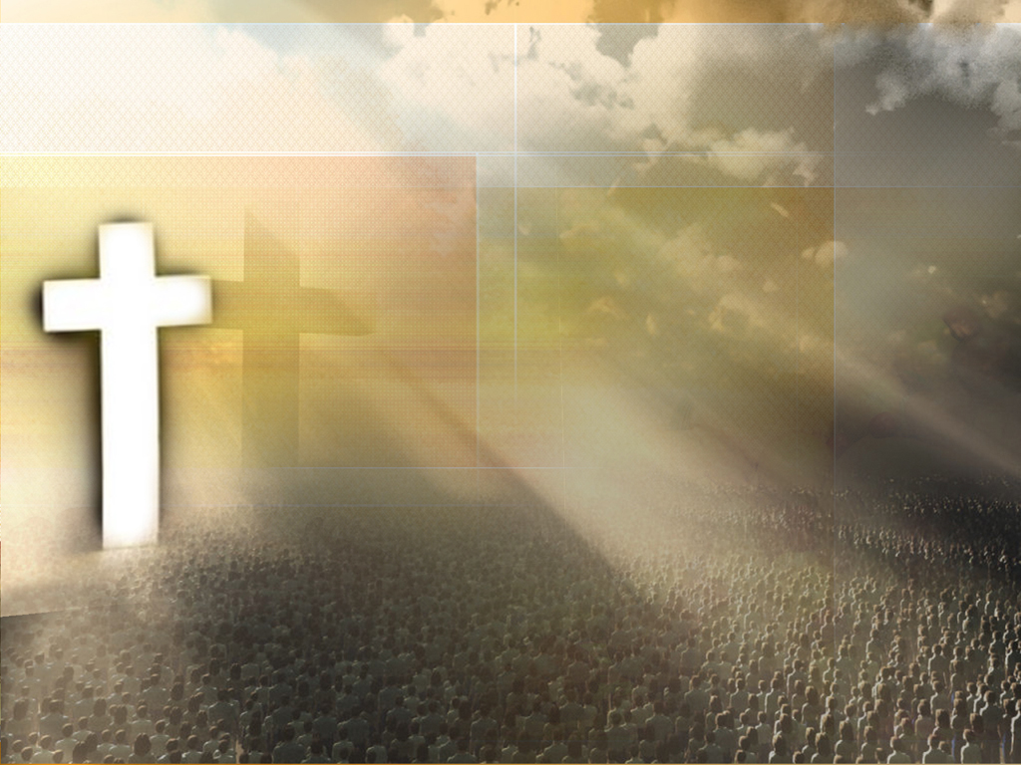
That’s Why We Praise Him

Slide 2
He came to live, live a perfect life
He came to be the living word of life
He came to die so we’d be reconciled
He came to rise to show His power & might

Slide 3
That’s why we praise Him that’s why we sing
That’s why we offer Him our everything
That’s why we bow down and worship this King
‘cause he gave His everything
‘cause he gave His everything

Slide 4
He came to live, live again in us
He came to be our conquering King and friend
He came to heal and show the lost ones his love
He came to go prepare a place for us

Slide 5
That’s why we praise Him that’s why we sing
That’s why we offer Him our everything
That’s why we bow down and worship this King
‘cause he gave His everything
‘cause he gave His everything

Slide 6
Halle, hallelujah, Halle, hallelujah
Halle, hallelujah, Halle, hallelujah
Halle, hallelujah, Halle, hallelujah
Halle, hallelujah, Halle, hallelujah

Slide 7
That’s why we praise Him that’s why we sing
That’s why we offer Him our everything
That’s why we bow down and worship this King
‘cause he gave His everything
‘cause he gave His everything

Slide 8
That’s why we praise Him that’s why we sing
That’s why we offer Him our everything
That’s why we bow down and worship this King
‘cause he gave His everything
‘cause he gave His everything
‘cause he gave His everything

